Slide 1
SOFTWARE CONFIGURATION MANAGEMENT

Slide 2

INTRODUCTION TO SCM

Slide 3
Context
All the software (code) constructed as part of Implementation will need to be reliably and effectively converted to executable code (Build), which can be tested and then released to the Customers.
Given that software engineering is for large projects, with a large number of people working concurrently on generating documentation and code for the product, located at different physical (even geographical) locations, there is a need for approaches or engineering processes which will support
Administering or managing the Code line, Branching, Merging or Integration and Version control of the source code
Building the Integrated or Merged code or software
Packaging the built software
Change Management
Generically activities involving all of the above activities (and few more discussed later) are typically considered for discussion as part of software configuration management
Notes:
Delivery management
Defect tracking and
Change management
are generically looked at as configuration management.
Standards (approved by ANSI)
IEEE 828: Software Configuration Management Plans
IEEE 1042: Guide to Software Configuration Management

Slide 4
What is Software Configuration Management
Software Configuration Management is a process to systematically organize, manage and control the changes in the documents, code and other entities which are outcomes of different phases of the Software Engineering process for the software product under consideration.
The primary goal is to increase productivity by increased and planned coordination among the programmers in a team and eliminates confusion and mistakes
SCM involves identifying individual elements & configurations, tracking changes, version selection, control and baselining.
This helps in avoiding configuration related problems, effective management of simultaneous updating of source files, build management, defect tracking
Notes:
Defect tracking
Change management and
Managing software configurations
are generically looked at as configuration management.
Standards (approved by ANSI)
IEEE 828: Software Configuration Management Plans
IEEE 1042: Guide to Software Configuration Management

Slide 5
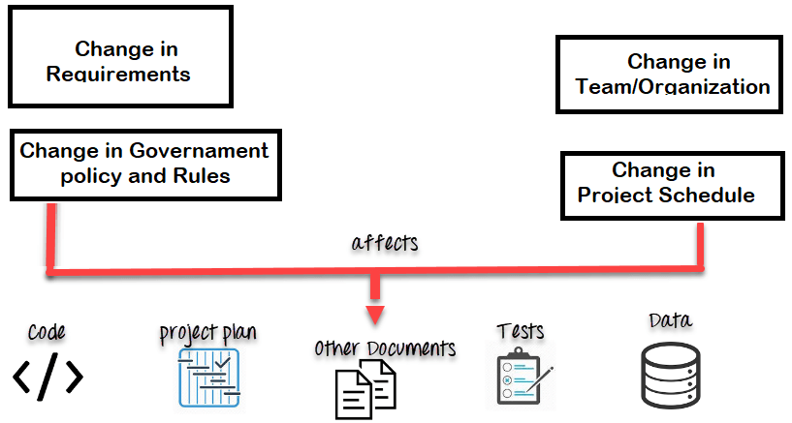
Why SCM
Software engineering in large products/projects with multiple people potentially across different locations need to be reliably managed for
multiple people concurrently working on the same piece of software & continuously updating the same
work on more than one version of the software
working on released systems
changes in configuration items due to changes to user requirements, budget, schedule etc.
custom configured systems (different functionality)
Code/software which must run on different machines and OS’s
Coordination among stakeholders
Controlling the costs involved in making changes to a system

Slide 6
SCM in Scrum-Agile Approach
SCM is the responsibility of the 'whole team’ and will need to be automated as much as possible and educated to the Scrum practitioners.
Typically, the definitive versions of components are held in a shared project repository.
Developers copy them into their own workspace, make changes to the code and then use system-building tools to create a new system on their own computer for testing.
Once they are happy with the changes made, they return the modified components to the project repository.
This makes the modified components available to other team members

Slide 7
Benefits of SCM
The effective use of an SCM system also:
Permits the orderly development of software configuration items.
Ensures the orderly release and implementation of new or revised software products.
Ensures that only approved changes to both new and existing software products are implemented and deployed.
Ensures that the software changes that are implemented are in accordance with approved specifications.
Ensures that the documentation accurately reflects updates.
Evaluates and communicates the impact of changes.
Prevents unauthorized changes from being made.

Slide 8
Configuration Management Roles
Configuration Manager
Responsible for identifying configuration items.
Defining the procedures for creating and promotions and releases
Change Control Board (CCB) member
Responsible for approving or rejecting change requests
Developer
Creates versions triggered by change requests or the normal activities of development
Checks in changes & resolves conflicts
Auditor
Responsible for validating the processes followed for selection and evaluation of promotions for release
Ensures the consistency and completeness of the release

Slide 9
Software Configuration Management Planning
Software Configuration Planning is done by a configuration Manager who would do this as a dedicated or part time role
Software configuration management planning starts during the early phases of a project.
The outcome of the SCM planning phase is the Software Configuration Management Plan (SCMP)
The SCMP can either follow a public standard like the IEEE 828, or an internal (e.g. company specific) standard.

Slide 10
Software Configuration Management Plan
Defines the CIs which need to be managed and a naming scheme.
Defines who takes responsibility for the CM procedures and the creation of baselines.
Defines policies for change control and version management.
Describes the tools which should be used to assist the CM process and any limitations on their use.
Defines the configuration management database used to record configuration information.

Slide 11
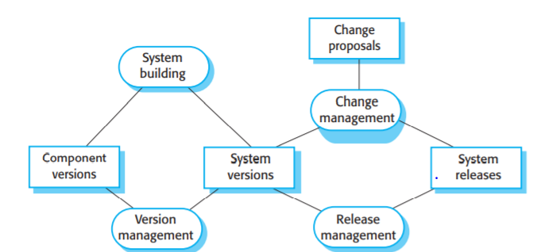
Configuration Management Activities
Configuration item identification
Configuration Management Directories
Baselining
Branch management
Version Management
Build Management
Install
Change Management
Promotion management
Release management
Defect Management

